Slide 1
Robodog

Slide 2
Understanding Self-Awareness & Limitations of AI in the Journey to AGI

Slide 3

Limitations of Large Language Models
Language models like GPT can generate human-like text but don't truly understand the content.
These models are heavily dependent on the quality and nature of the input data.
Unlike humans, these models don't have self-awareness or consciousness.
Are Path to Artificial General Intelligence (AGI)

Slide 4
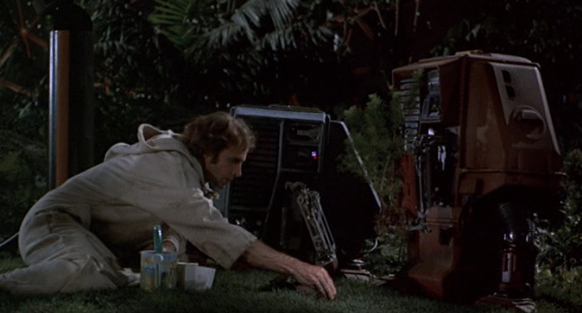
Theories of Self-Awareness
The theory of Mind suggests that self-awareness stems from our ability to comprehend that others have different experiences and thoughts.
The protagonist theory proposes that we see ourselves as the central character in our life's narrative, leading to self-awareness.
Emergent self theory implies that self-awareness evolves from our interactions and relationships with others.

Slide 5
Robodog
A comprehensive and portable tool designed to tokenize knowledge artefacts and interact with large language models (LLMs)

Slide 6
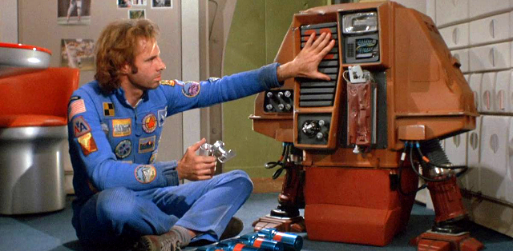
Why Create Robodog
A pre-trained transformer-based model is trained on the Internet, and data is licensed by third-party providers.
These models are useful, but what we really need is to inject our own knowledge artefacts into them.

Slide 7
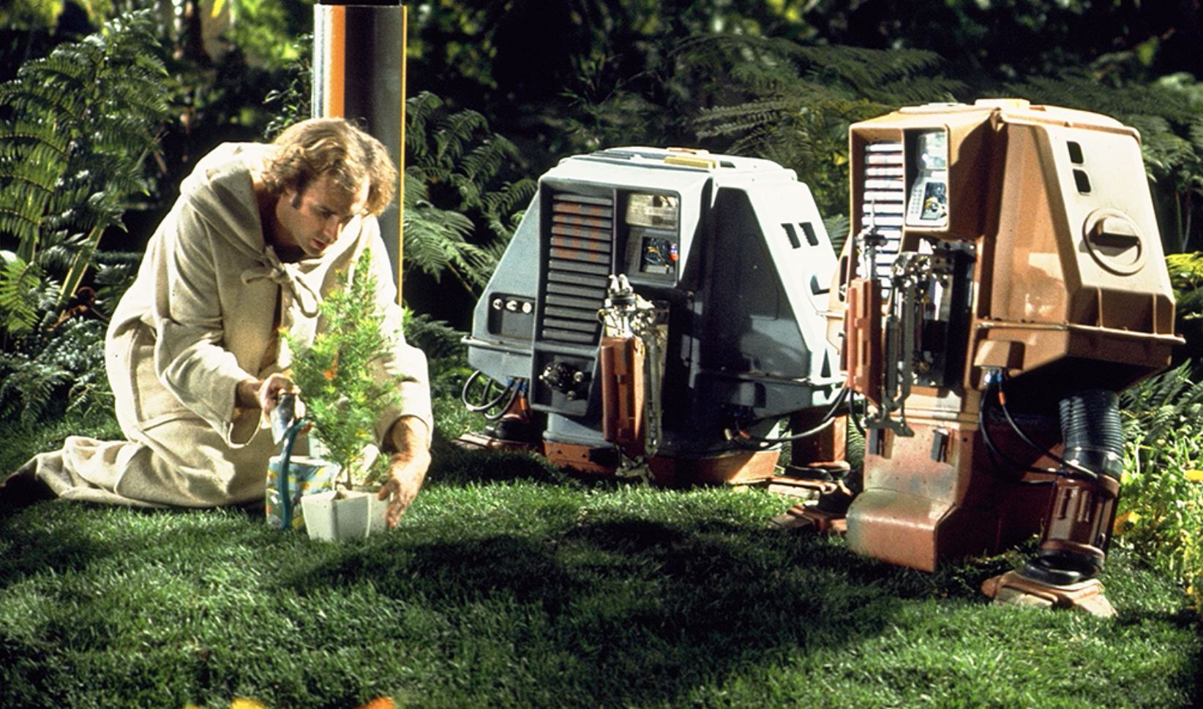
Knowledge Artifacts
Where Robodog attempts to comes in.
Our personal knowledge artifacts are fragmented into many formats
They are embedded into many providers: Google, Microsoft, Dropbox, Adobe, Apple
They are in many formats like images: PDF, text, email, tasks, and notes.
With Robodog, we can traverse our artefacts and convert them into a format that a model can interact with the transformer model.

Slide 8
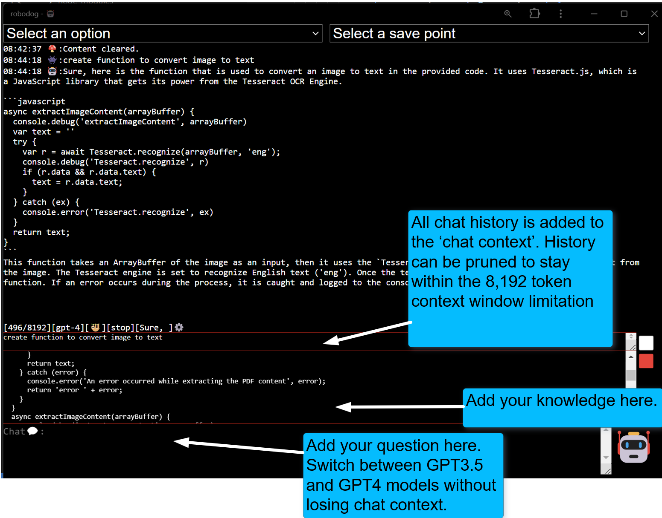
How it Robodog Works

Slide 9
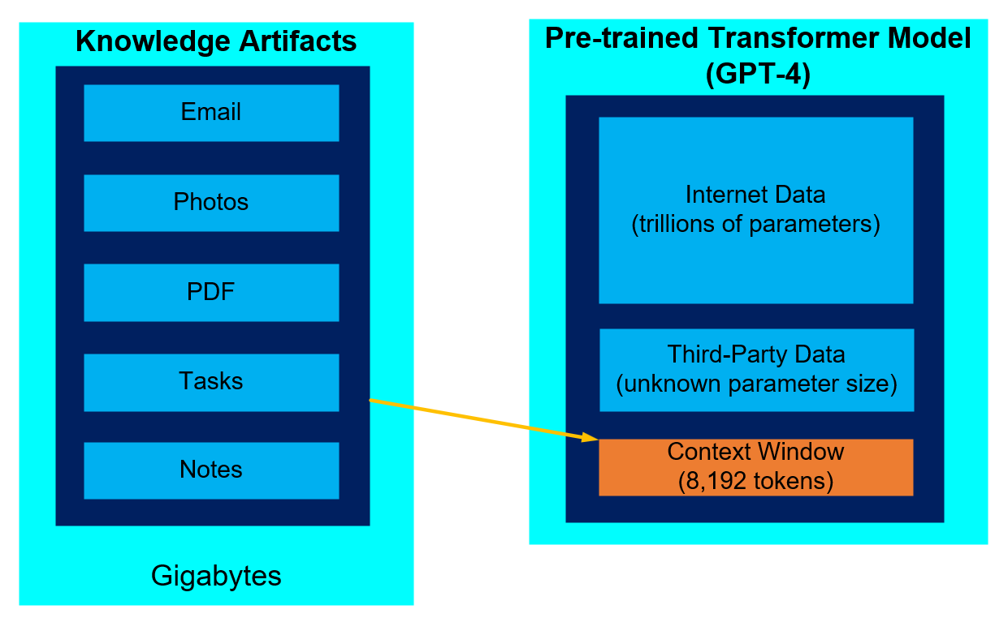
Knowledge Artifacts vs Context Window
There is no way around the limitations of the context window size.
Less expensive models are 4,000 tokens and more expensive models are 128,000 tokens
There is a need to prune the context window
The open ai custom GPT product attempts to automate pruning process using an elastic search. From experience, this does not work very well in practice

Slide 10
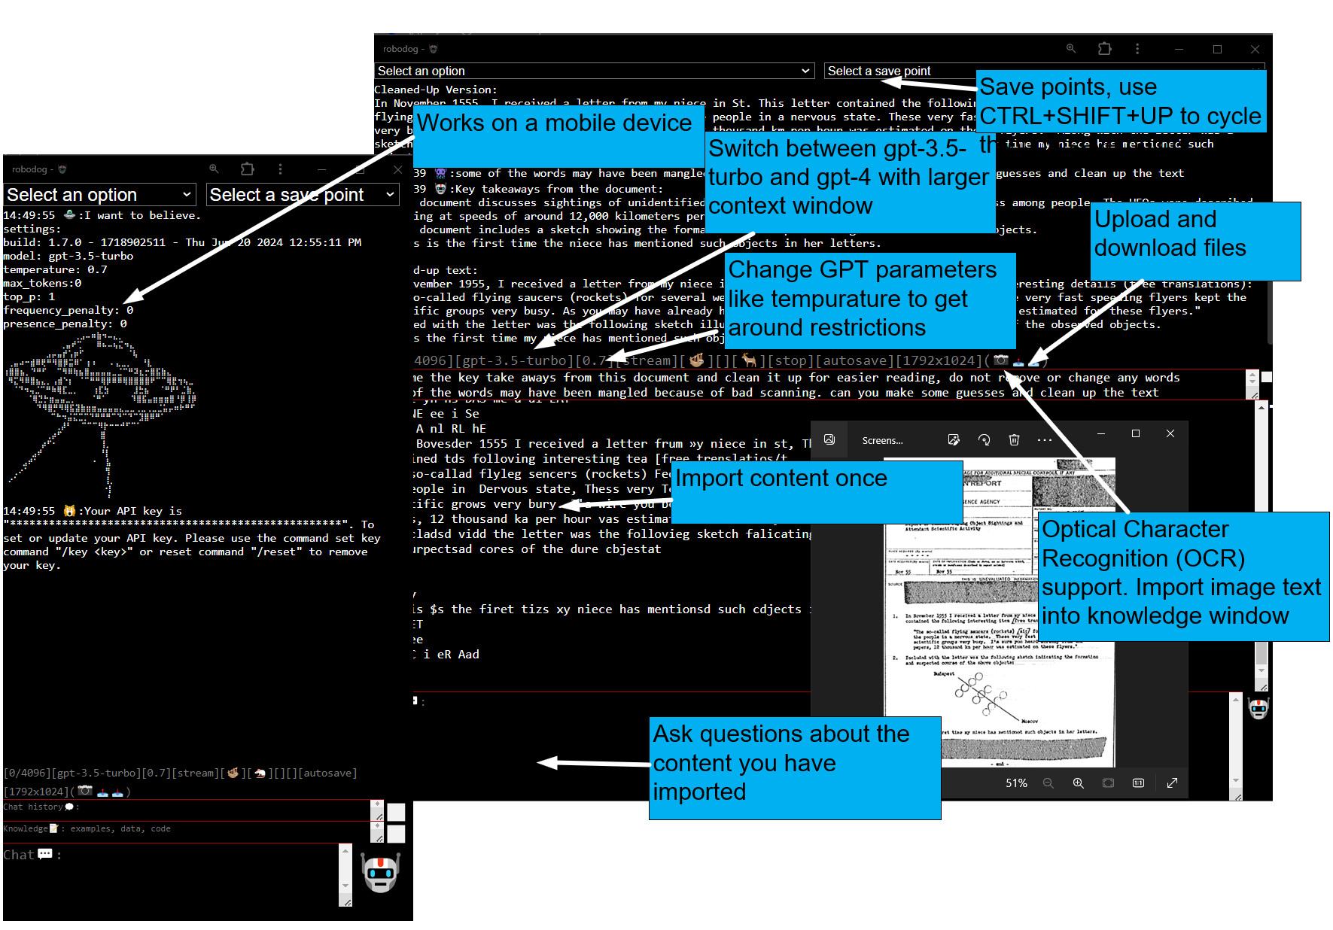
Robodog Features

Slide 11
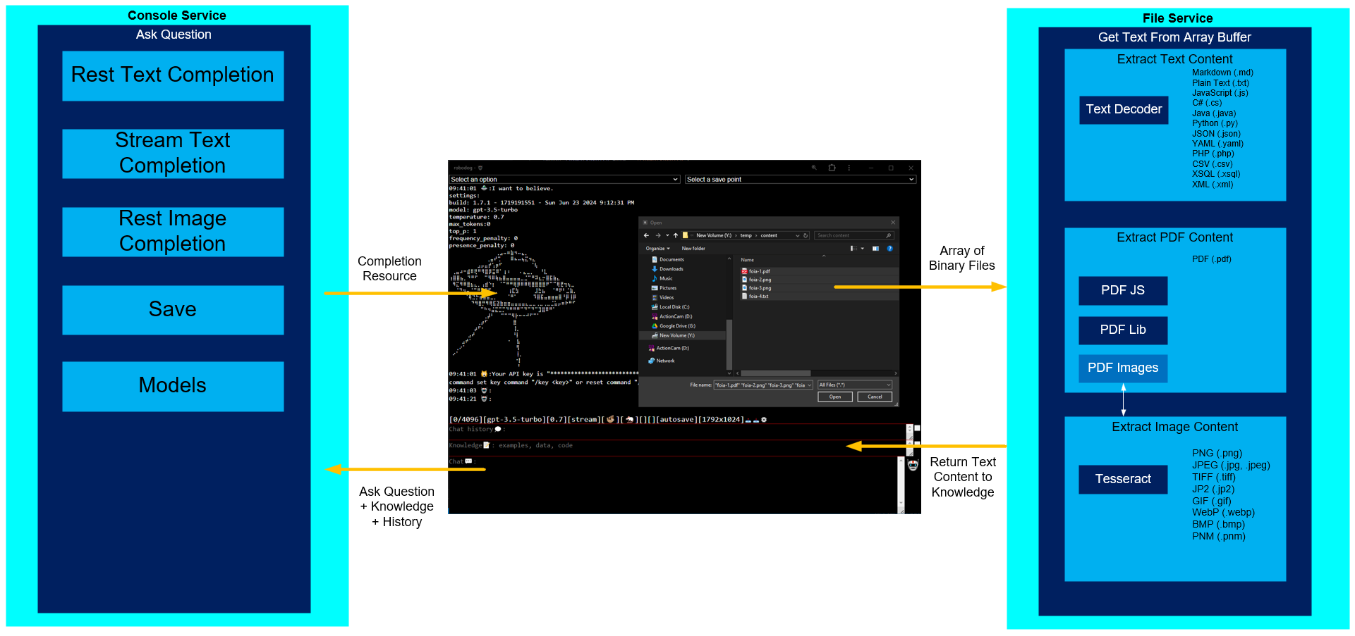
Separation of Concerns

Slide 12
Conclusion

Slide 13
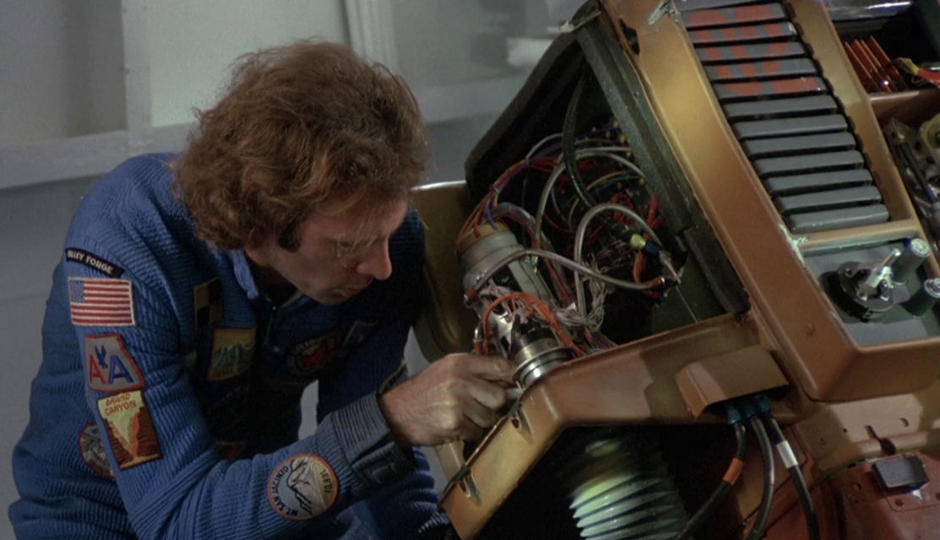
Path to Artificial General Intelligence (AGI)
Incremental Improvements: Continuous enhancements in AI models and techniques.
Interdisciplinary Research: Combining insights from psychology, neuroscience, and computer science.
Ethical Guidelines: Establishing guidelines to ensure the responsible development and use of AGI.

